Slide 1
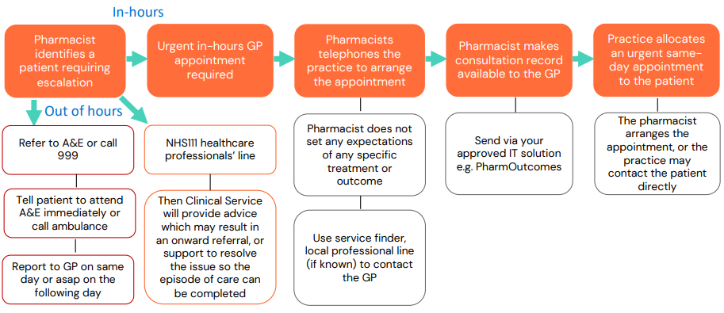
Pharmacy First –
Urgent Escalation Process

Slide 2
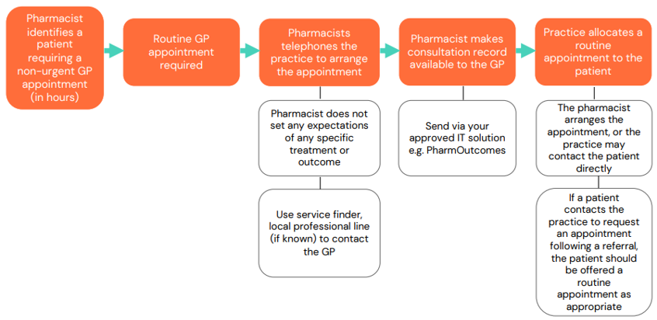
Pharmacy First –
Non-Urgent Escalation Process

Slide 3
Points to Note
Urgent and Non-Urgent Escalation Process - you can use the document as long as you reference that this was developed by CPGM.
Referral and Communication Process - ensure NHS Devon ICB are credited (ideally with a link to our webpage).
Format/layout of toolkit – include shoutout to NHS SHROPSHIRE, TELFORD AND WREKIN ICB where work originated

